Slide 1
Verilog HDL语言
主讲：胡迪青
Email: hudq024@mail.hust.edu.cn
QQ: 121374333
华中科技大学计算机科学与技术学院

Slide 2
Verilog语言基础

Slide 3
间隔符：空格、TAB键、换行符及换页符
注释
  单行注释用//标志起头和回车符结尾
  多行注释用/*标志起头和*/标志结尾
标识符
  可以是任意一组字母、数字、$符号和_(下划线)符号的组合；
  必须是由字母或下划线开头，长度小于1024字符；
  转义标识符以反斜杠“\”开头，以空白符结尾的任何字符序列；
  标识符区分大、小写。
关键词：Verilog HDL 内部已使用的词，关键词都是小写。
格式：区分大小写。自由格式，即结构可以跨越多行编写。

Slide 4
Identifiers (Signal Names)
Identifiers are the names you choose for your signals
In a programming language you should choose descriptive variable names. In a HDL you should choose descriptive signal names.
  Use mixed case and/or _ to delimit descriptive names.
    assign parityErr = ^serial_reg;
    nxtState = returnRegister;
  Have a convention for signals that are active low
    Many errors occur on the interface between blocks written by 2 different people. One assumed a signal was active low, and the other assumed it was active high
    I use _n at the end of a signal to indicate active low
    rst_n = 1’b0 // assert reset
Slide taken direct from Eric Hoffman

Slide 5
Verilog 基础知识
四种基本的值
  0：逻辑0或“假”
  1：逻辑1或“真”
  x：未知
  z：高阻
三类常量
  整型数：简单的十进制格式，基数格式（5’O37，4’B1x_01）
  实数：十进制计数法，科学计数法
  字符串：字符串是双引号的字符序列，字符串不能分成多行书写
参数
  参数是一个常量，经常用于定义时延和变量的宽度等。
信号等级 | 信 号 强 度 | 关 键 字
7 | Supply Drive | supply0 | supply1
6 | Strong Drive | strong0 | strong1
5 | Pull Drive | pull0 | pull1
4 | Large Capacitance | large
3 | Weak Drive | weak0 | weak1
2 | Medium Capacitance | medium
1 | Small Capacitance | small
0 | Hi Impedance (no drive) | highz0 | highz1

Slide 6
Resolving 4-Value Logic
S
A
OUT
A
OUT
A
T
OUT
B
B
B
A B OUT
A B OUT
S A T B OUT
0 0 0
0 1 1
1 1 1
0 x
0 z
1 x
1 z
0 0 0
0 1 0
1 1 1
0 x
0 z
1 x
1 z
0 0 z z
0 1 z x
0 x z 1
0 z z 0
1 0 0 1
1 0 0 z
1 1 1 z
1 x x z
1 z x 0
z
x
1
X
0
0
X
0
x
1
x
0
1
x
1
x
x
OUT
A
OUT
0 1 x z
1 0 x
A
X
Slide taken direct from Eric Hoffman

Slide 7
Numbers in Verilog
General format is: <size>’<base><number>
Examples:
  4’b1101 // this is a 4-bit binary number equal to 13
  10’h2e7 // this is a 10-bit wide number specified in hex
Available bases:
  d = decimal (please only use in test benches)
  h = hex (use this frequently)
  b = binary (use this frequently for smaller #’s)
  o = octal (who thinks in octal?, please avoid)
Slide taken direct from Eric Hoffman

Slide 8
Numbers in Verilog
Numbers can have x or z characters as values
  x = unknown, z = High Impedance
  12’h13x // 12-bit number with lower 4-bits unknown
If size is not specified then it depends on simulator/machine.
  Always size the number for the DUT verilog
    Why create 32-bit register if you only need 5 bits?
    May cause compilation errors on some compilers
Supports negative numbers as well
  -16’h3A // this would be -3A in hex (i.e. FFC6 in 2’s complement)
  I rarely if ever use this. I prefer to work 2’s complement directly
Slide taken direct from Eric Hoffman

Slide 9
Parameters & Define
Parameters are useful to make your code more generic/flexible. Read about it in text. More later…
`define statement can make code more readable
`define idle = 2’b00; // idle state of state machine
`define conv = 2’b01; // in this state while A2D converting
`define avg = 2’b10; // in this state while averaging samples
.
.
.
case (state)
`idle : if (start_conv) nxt_state = `conv;
else nxt_state = `idle
`conv : if (gt) nxt_state = `avg;
else nxt_state = `conv;
.
.
.
Bad Example…Don’t Use `define for state assignment
Use parameters instead. `define should be truly global thing
Slide taken direct from Eric Hoffman

Slide 10
Parameters & Define
localparam idle = 2’b00; // idle state of state machine
localparam conv = 2’b01; // in this state while A2D converting
localparam accum = 2’b10; // in this state while averaging samples
.
.
.
case (state)
idle : if (start_conv) nxt_state = conv;
else nxt_state = idlle
conv : if (gt) nxt_state = avg;
else nxt_state = conv;
.
.
.
Slide taken direct from Eric Hoffman

Slide 11
数据类型
  线网类型（wire）。net type表示Verilog结构化元件间的物理连线。它的值由驱动元件的值决定；如果没有驱动元件连接到线网，线网的缺省值为z。
  寄存器类型（reg）。register type表示一个抽象的数据存储单元，它只能在always语句和initial语句中被赋值，并且它的值从一个赋值到另一个赋值被保存下来。寄存器类型的变量具有x的缺省值。

Slide 12
Nets数据类型：表示元件之间的结构化连接
  wire和tri线网：是最常见的线网类型。
  wor和trior线网：如果某个驱动源为1，那么线网的值也为1。
  wand和triand线网：如果某个驱动源为0，那么线网的值为0。
  trireg线网：此线网存储数值（类似于寄存器），并且用于电容节点的建模。
  tri0和tri1线网：这类线网可用于线逻辑的建模，即线网有多于一个驱动源。
  supply0和supply1线网：supply0用于对“地”建模，即低电平0；supply1用于对电源建模，即高电平1。

Slide 13
Register数据类型：在程序块中作变量用，对信号赋值需要用该数据类型，赋值时用关键字initial或always开始。
  reg寄存器类型：是最常见的数据类型。
  integer寄存器类型：整数寄存器包含整数值，可以作为普通寄存器使用，典型应用为高层次行为建模。
  time类型：用于存储和处理时间。
  real和realtime类型：实数寄存器（或实数时间寄存器）。

Slide 14
Registers in Verilog
Registers are storage nodes
  They retain their value till a new value is assigned
  Unlike a net (wire) they do not need a driver
  Can be changed in simulation by assigning a new value
Registers are not necessarily FlipFlops
  In your DUT Verilog registers are typically FlipFlops
  Anything assigned in an always or initial block must be assigned to a register
  You will use registers in your testbenches, but they will not be FlipFlops
Slide taken direct from Eric Hoffman

Slide 15
Vectors in Verilog
Vectors are a collection of bits (i.e. 16-bit wide bus)
////////////////////////////////////////////////////////////////////
// Define the 16-bit busses going in and out of the ALU //
//////////////////////////////////////////////////////////////////
wire [15:0] src1_bus,src2_bus,dst_bus;
///////////////////////////////////////////////////////////////
// State machine has 8 states, need a 3-bit encoding //
/////////////////////////////////////////////////////////////
reg [2:0] state,nxt_state;
Bus ≠ Vector (how are they different?)
Slide taken direct from Eric Hoffman

Slide 16
Vectors in Verilog
Can select parts of a vector (single bit or a range)
module lft_shift(src,shft_in,result,shft_out);
input [15:0] src;
input shft_in;
output [15:0] result;
output shft_out;
/////////////////////////////////////////////////////////////////////////
// Can access 15 LSB’s of src with [14:0] selector //
// { , } is a process of concatenating two vectors to form one //
//////////////////////////////////////////////////////////////////////
assign result = {src[14:0],shft_in};
assign shft_out = src[15]; // can access a single bit MSB with [15]
endmodule
src
16
shft_out
left shift
shft_in
16
result
Slide taken direct from Eric Hoffman

Slide 17
Arrays & Memories
Can have multi-dimentional arrays
  reg [7:0] mem[0:99][0:3]; // what is this?
addr1
Often have to model memories
  RF, SRAM, ROM, Flash, Cache
  Memories can be useful in your test bench
RF
Flash
I²C
addr2
src1
src2
ALU
wire [15:0] src1,src2; // source busses to ALU
reg [15:0] reg_file[0:31];// Register file of 32 16-bit words
reg [4:0] addr1,addr2; // src1 and src2 address
.
.
.
src1 = reg_file[addr1]; // transfer addressed register file
// to src1 bus
result
Slide taken direct from Eric Hoffman

Slide 18
系统任务和函数
  以$字符开始的标识符表示系统任务或系统函数；
  任务提供了一种封装行为的机制，任务可以返回0个或多个值；
  函数除只能返回一个值以外与任务相同；
  函数在0时刻执行，即不允许延迟，而任务可以带有延迟。
编译指令：以`（反引号）开始的某些标识符
  `define和`undef，`ifdef、`else和 `endif，`default_nettype
  `include，`resetall，`timescale
  `unconneted_drive和`nounconnected_drive
  `celldefine和`endcelldefine

Slide 19
Useful System Tasks
$display: Like printf in C. Useful for testbenches and debug
$display(“At time %t count = %h”,$time,cnt);
$stop ➔ Stops simulation and allows you to still probe signals and debug
$finish ➔ completely stops simulation, simulator relinquishes control of thread.
Also useful is `include for including code from another file (like a header file)
Read about these features of verilog in your text
Slide taken direct from Eric Hoffman

Slide 20
时延
Verilog HDL模型中的所有时延都根据单位定义。
下面是带时延的连续赋值语句实例：
assign #2 Sum = A ^ B;
#2指2个时间单位。
如果没有说明时延时间单位，Verilog HDL模拟器会指定一个缺省时间单位。
IEEE Verilog HDL标准中没有规定缺省时间单位。

Slide 21
Timing Controls For Simulation
Can put “delays” in a Verilog design
  Gates, wires, & behavioral statements
Delays are useful for Simulation only!
  Used to approximate “real” operation while simulating
  Used to control testbench
SYNTHESIS
  Synthesis tool IGNORES these timing controls
    Cannot tell a gate to wait 1.5 nanoseconds
    Delay is a result of physical properties
  Only timing (easily) controlled is on clock-cycle basis
    Can tell synthesizer to attempt to meet cycle-time restriction
Slide taken direct from Eric Hoffman

Slide 22
Zero Delay vs. Unit Delay
When no timing controls specified: zero delay
  Unrealistic – even electrons take time to move
  OUT is updated same time A and/or B change:
  and A0(OUT, A, B)
Unit delay often used
  Not accurate either, but closer…
  “Depth” of circuit does affect speed!
  Easier to see how changes propagate through circuit
  OUT is updated 1 “unit” after A and/or B change:
  and #1 A0(OUT, A, B);
Slide taken direct from Eric Hoffman

Slide 23
Zero/Unit Delay Example
A
Z
Y
Zero Delay
Unit Delay
B
T A B C Y Z
C
T A B C Y Z
0
1
2
3
4
5
6
7
8
9
10
11
12
13
14
15
16
0 1 0 x x
0 1 0 0 x
0 1 0 0 0
0 1 1 0 0
0 1 1 1 0
0 1 1 1 1
1 0 0 1 1
1 0 0 0 1
1 1 1 0 1
1 1 1 1 1
1 0 0 1 1
1 0 0 0 1
0 1 0 0 1
0 1 0 0 0
0 1 1 0 0
0 1 1 1 0
0 1 1 1 1
0
1
2
3
4
5
6
7
8
9
10
11
12
13
14
15
0 0 0 0 0
0 0 1 0 0
0 1 0 0 0
0 1 1 1 1
1 0 0 0 1
1 0 1 0 1
1 1 0 0 1
1 1 1 1 1
0 0 0 0 0
0 0 1 0 0
0 1 0 0 0
0 1 1 1 1
1 0 0 0 1
1 0 1 0 1
1 1 0 0 1
1 1 1 0 1
Zero Delay:
Y and Z change at same “time” as A, B, and C!
Slide taken direct from Prof. Schulte
Unit Delay:
Y changes 1 unit after B, C
Unit Delay:
Z changes 1 unit after A, Y
Slide taken direct from Eric Hoffman

Slide 24
Types Of Delays
Inertial Delay (Gates)
  Suppresses pulses shorter than delay amount
  In reality, gates need to have inputs held a certain time before output is accurate
  This models that behavior
Transport Delay (Nets)
  “Time of flight” from source to sink
  Short pulses transmitted
Not critical for our project, however, in industry
  After APR(Automatic Placement & Routing) an SDF(Standard Delay Format) is applied for accurate simulation
  Then corner simulations are run to ensure design robust
Slide taken direct from Eric Hoffman

Slide 25
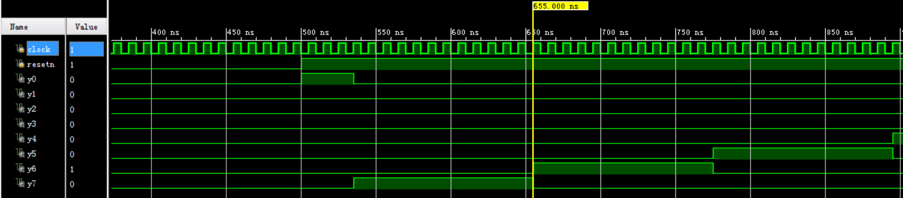
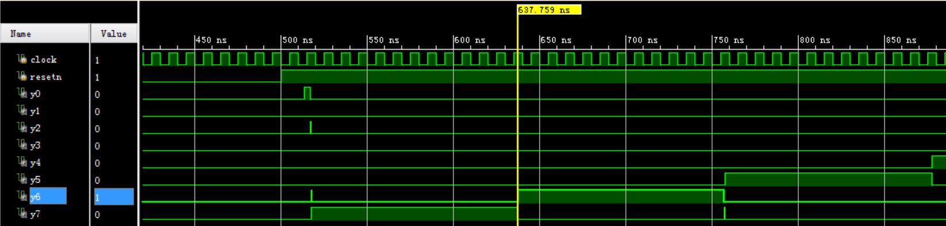

Slide 26
Delay Examples
wire #5 net_1; // 5 unit transport delay
and #4 (z_out, x_in, y_in); // 4 unit inertial delay
assign #3 z_out = a & b; // 3 unit inertial delay
wire #2 z_out; // 2 unit transport delay
and #3 (z_out, x_in, y_in); // 3 for gate, 2 for wire
wire #3 c; // 3 unit transport delay
assign #5 c = a & b; // 5 for assign, 3 for wire
Slide taken direct from Eric Hoffman

Slide 27
Verilog 运算符
运算符（9类）
  算术运算符： +、-、*、/、%
  位运算符： ~、&、|、^、^~、~^
  缩位运算符（单目）： &、~&、|、~|、^、^~、~^
  逻辑运算符： !、&&、||
  关系运算符（双目）： <、>、<=、>=
  相等与全等运算符： ==、!=、===、!==
  逻辑移位运算符： <<、>>
  连接运算符： { }
  条件运算符： ? :

Slide 28
Reduction Operators
Reduction operators are reduce all the bits of a vector to a single bit by performing an operation across all bits.
  Reduction AND
    assign all_ones = &accumulator; // are all bits set?
  Reduction OR
    assign not_zero = |accuumulator; // are any bits set?
  Reduction XOR
    assign parity = ^data_out; // even parity bit

Slide 29
Vector concatenation
Can “build” vectors using smaller vectors and/or scalar values
Use the {} operator
Example 1
becomes
8-bit vector:
a₁a₀b₁b₀c₁c₀da₂
module concatenate(out, a, b, c, d);
input [2:0] a;
input [1:0] b, c;
input d;
output [9:0] out;
assign out = {a[1:0],b,c,d,a[2]};
endmodule
Slide taken direct from Eric Hoffman

Slide 30
Conditional Operator
This is a favorite!
  The functionality of a 2:1 Mux
  assign out = conditional_expr ? true_expr : false_expr;
Examples:
// a 2:1 mux
assign out = select ? in0 : in1;
// tri-state bus
assign src1 = rf2src1 ? Mem[addr1] : 16’hzzzz;
// Either true_expr or false_expr can also be a conditional operator
// lets use this to build a 4:1 mux
assign out = sel[1] ? (sel[0] ? in3 : in2) : (sel[0] ? in1 : in0);
false_expr
0
out
true_expr
1
cond_expr
Slide taken direct from Eric Hoffman

Slide 31
Conditional assign (continued)
Examples: (nesting of conditionals)
`define add 3'b000
`define and 3'b001
`define xor 3'b010
`define shft_l 3'b011
`define shft_r 3'b100
// an ALU capable of arithmetic,logical, shift, and zero
assign {cout,dst} = (op==`add) ? src1+src2+cin :
(op==`and) ? {1’b0,src1 & src2} :
(op==`xor) ? {1’b0,src1 ^ src2} :
(op==`shft_l) ? {src1,cin} :
(op==`shft_r) ? {src1[0],src1[15],src1[15:1]} :
17’h00000;
This can be very confusing to read if not coded with proper formating
Slide taken direct from Eric Hoffman

Slide 32

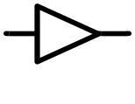










门电平模型化
在Verilog HDL语言中已预定义了门级原型
and n-input AND gate
nand n-input NAND bate
or n-input OR gate
nor n-input NOR gate
xor n-input exclusive
OR gate
xnor n-input exclusive
NOR gate
buf n-output buffer
not n-output inverter
bufif0 tri-state buffer;
Io enable
bufif1 tri-state buffer;
hi enable
notif0 tri-state inverter;
Io enable
notif1 tri-state inverter;
hi enable

Slide 33
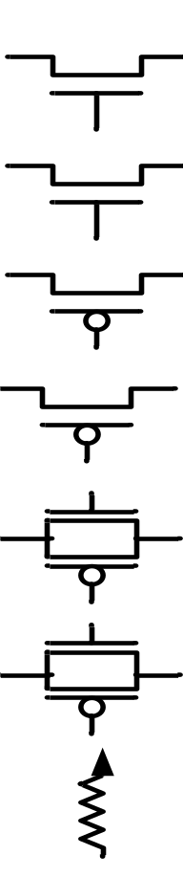
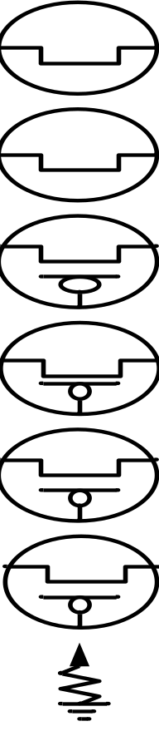
在Verilog HDL语言中已预定义了单向和双向的晶体管级原型
Pmos uni-directional
PMOS switch
rpmos resistive
PMOS switch
nmos uni-directional
NMOS switch
rnmos resistive
NMOS switch
cmos uni-directional
CMOS switch
rcmos resistive
CMOS switch
pullup pullup resistor
tran bi-directional pass
transistor
rtran resistive pass
transistor
tranif0 bi-directional
trnasistor;Io enable
rtranif resistive transitor;
Io enable
tranif1 bi-directional
transistor;hi enable
rtranif1 resistive transistor;
hi enable
pulldow pulldown resistor

Slide 34
用户定义的原语
UDP的定义
primitive UDP_name (OutputName, List_of_inputs)
Output_declaration
List_of_input_declarations
[Reg_declaration]
[Initial_statement]
table
List_of_tabel_entries
endtable
endprimitive

Slide 35
在组合电路UDP中，表规定了不同的输入组合和相对应的输出值。
在时序电路UDP中，使用1位寄存器描述内部状态。该寄存器的值是时序电路UDP的输出值。共有两种不同类型的时序 电路UDP：
  模拟电平触发行为
  模拟边沿触发行为
时序电路UDP使用寄存器当前值和输入值决定寄存器的下一状态（和后继的输出）。

